Slide 1

Acropolis Institute of Technology & Research, Indore

Slide 2
Eradicating Communication Gap between Specially-Abled and Normal Communities using Deep Learning
Submitted to:
Department of Information Technology/ CSE-DS

Slide 3
Team Members
Lakhan Patel
Sarthak Joshi
Sumit Mandloi
Tanisha Dubey
Supervised by:
Prof. Pawan Kumar Gupta

Slide 4
Project Presentation Outline
Abstract
Flowchart
Use case Diagram
Data flow Diagram
E.R. diagram
Algorithms
Methodology

Slide 5

Abstract
The differently abled people are not able to easily communicate their thoughts and talks with other people. So, it is the greatest need of this hour to think and act upon the development of such people as they are also an equal part of our society.
Our model proposes a finely tuned solution to mitigate this problem of the ever-increasing communication gap between differently-abled people and normal people.

Slide 6
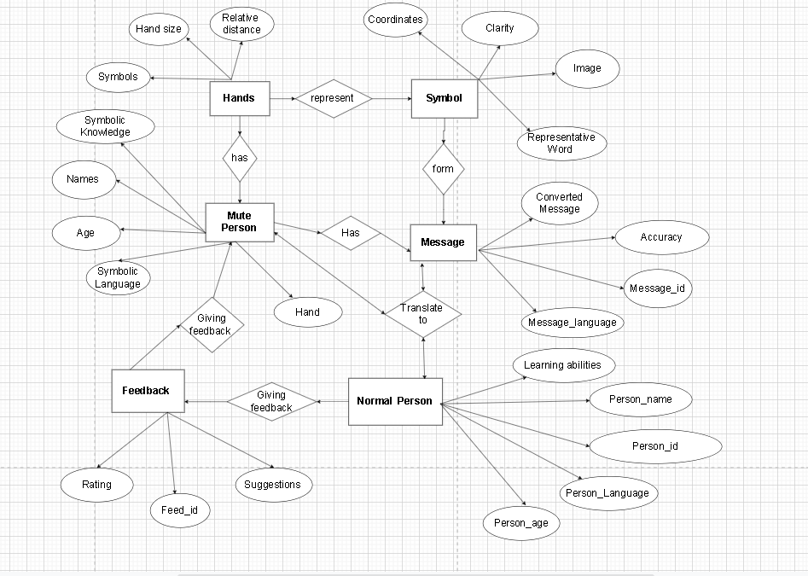
ER DIAGRAM
An Entity Relationship (ER) Diagram is a type of flowchart that illustrates how “entities” such as people, objects or concepts relate to each other within a system. ER Diagrams are most often used to design or debug relational databases in the fields of software engineering, business information systems, education and research. Also known as ERDs or ER Models, they use a defined set of symbols such as rectangles, diamonds, ovals and connecting lines to depict the interconnectedness of entities, relationships and their attributes.

Slide 7
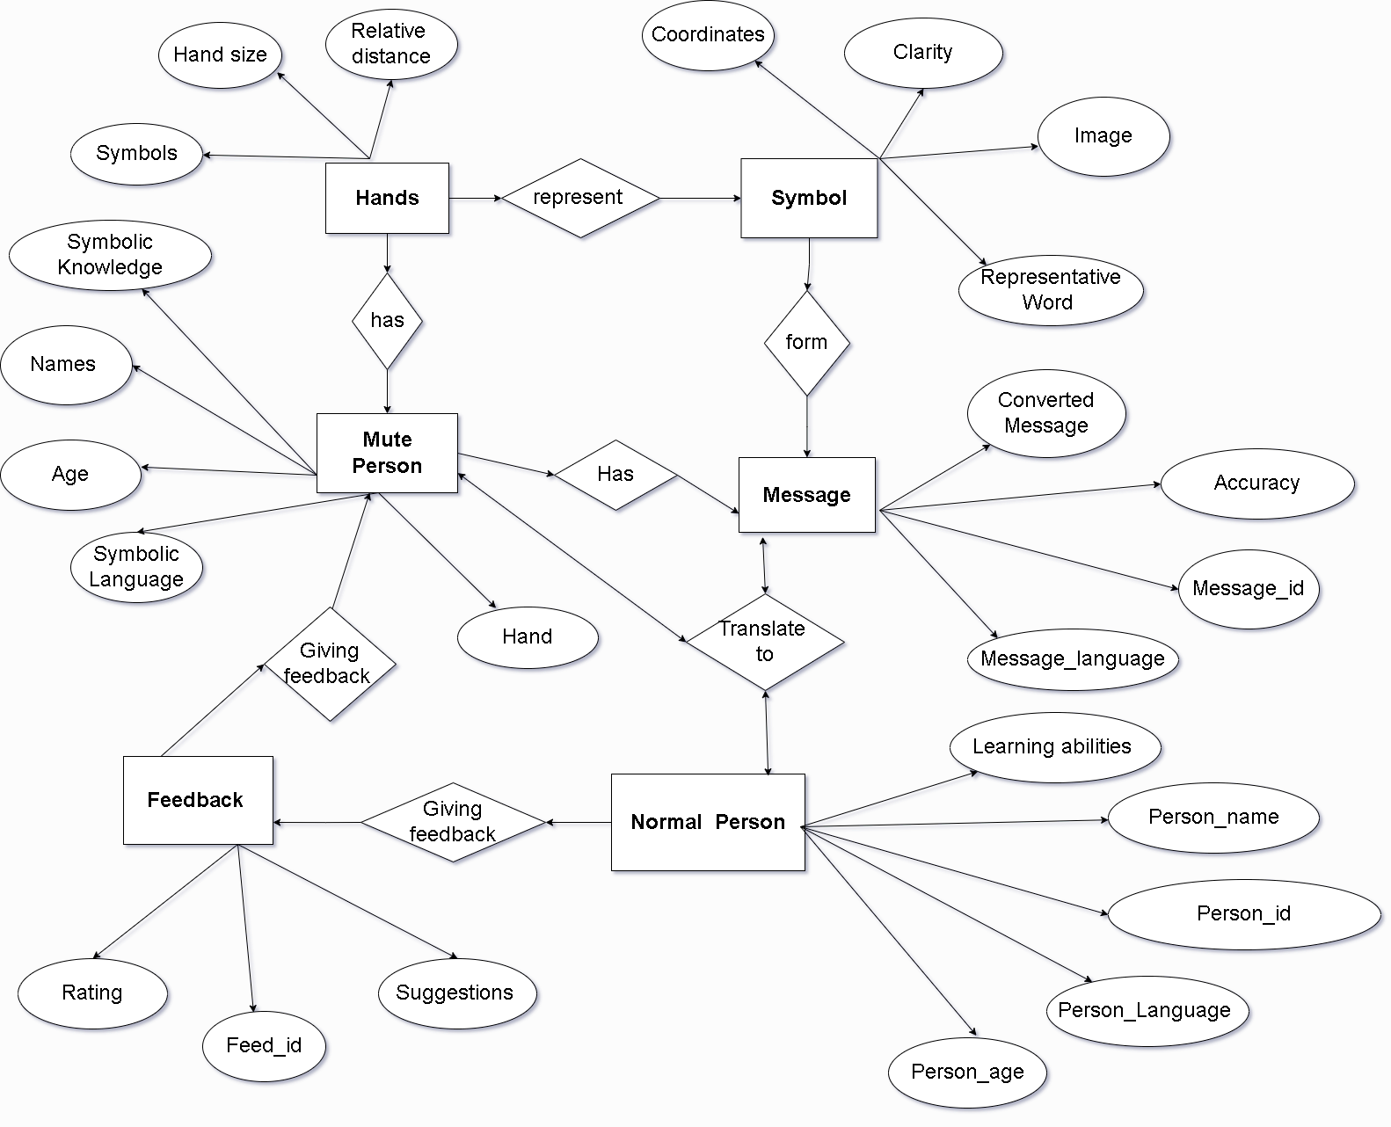
ER DIAGAM

Slide 12
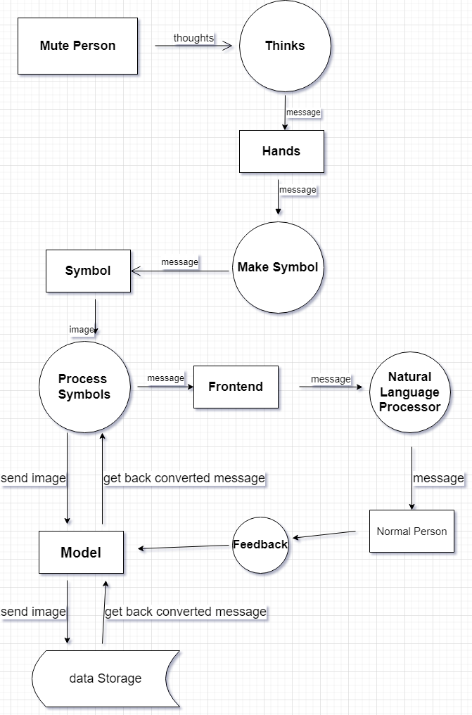
Data Flow Diagram
A data flow diagram (DFD) maps out the flow of information for any process or system. It uses defined symbols like rectangles, circles and arrows, plus short text labels, to show data inputs, outputs, storage points and the routes between each destination. Data flowcharts can range from simple, even hand-drawn process overviews, to in-depth, multi-level DFDs that dig progressively deeper into how the data is handled. They can be used to analyze an existing system or model a new one.

Slide 18
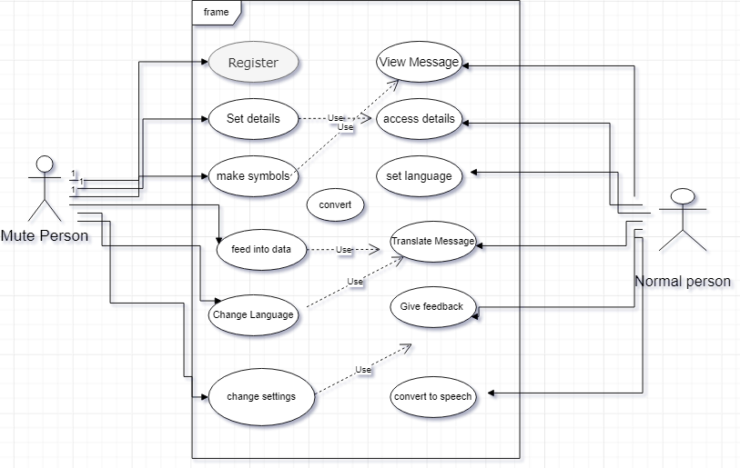
Use Case Diagram
In the Unified Modeling Language (UML), a use case diagram can summarize the details of your system's users (also known as actors) and their interactions with the system. To build one, you'll use a set of specialized symbols and connectors. An effective use case diagram can help your team discuss and represent:
Scenarios in which your system or application interacts with people, organizations, or external systems
Goals that your system or application helps those entities (known as actors) achieve
The scope of your system

Slide 19
Use Case Diagram

Slide 23
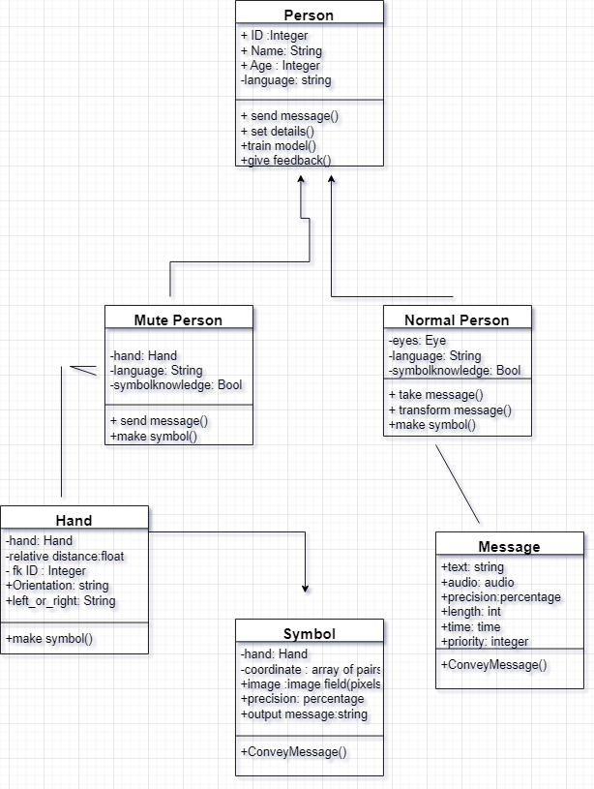
Class Diagram
One of the more popular types in UML is the class diagram. Popular among software engineers to document software architecture, class diagrams are a type of structure diagram because they describe what must be present in the system being modeled.
Since classes are the building block of objects, class diagrams are the building blocks of UML. The various components in a class diagram can represent the classes that will actually be programmed, the main objects, or the interactions between classes and objects.
The class shape itself consists of a rectangle with three rows. The top row contains the name of the class, the middle row contains the attributes of the class, and the bottom section expresses the methods or operations that the class may use. Classes and subclasses are grouped together to show the static relationship between each object.

Slide 24
Class Diagram

